Slide 1
HCI · CHAPTER 12 · EVALUATION
Observing Users
From raw behavior to design insight
BSc in Computer Science & Engineering · Human-Computer Interaction
Based on Dix, Finlay, Abowd & Beale — “Observing Users”

Slide 2
LEARNING OBJECTIVES
By the End of This Class, You Can...
1
Select a method
2
Apply a framework
Match an observation technique (lab vs. field, note-taking vs. logging) to a study's goals and constraints.
Use Goetz & LeCompte's 7-Ws to turn messy observation into structured field notes.
3
Instrument software
4
Go from data to design
Design a minimal event-logging schema to capture interaction data automatically.
Trace a qualitative pattern in a transcript to a concrete, testable redesign proposal.
03

Slide 3
USER
???

Slide 4
MOTIVATION
Why Observe Users?
Context
Technology
Interaction
Physical & social setting shape use
How the artifact is actually handled
The moment-to-moment behavior
A form that's easy alone may fail in a noisy ward with interruptions every 90 seconds.
Where fingers, eyes and devices go — not where the specification says they should.
Hesitations, backtracking and workarounds that surveys and interviews never surface.
THE CORE TRADE-OFF
Ecological validity (realistic, messy, field data) vs. experimental control (clean, comparable, lab data). Observation studies sit on this spectrum — you rarely get both at full strength.
04

Slide 5
SETTING
Where Do We Observe?
Controlled Environment
In the Field
Usability lab
Contextual inquiry, “in the wild”
1
Fixed tasks, script, and equipment
1
Real device, real workspace, real interruptions
2
Easy to record (fixed cameras, mic array)
2
Richer, messier, harder to instrument
3
High comparability across participants
3
Reveals workarounds a lab never would
4
Risk: behavior doesn't transfer to real use
4
Risk: hard to compare across sessions
05

Slide 6
WHO'S WATCHING?
The Observer's Stance
Outsider
Participant
Ethnographer
Watches without joining; minimal influence on behavior
Joins the activity while observing from inside it
Embeds long-term to understand culture & norms
TECHNICAL NOTE — REACTIVITY
The Hawthorne effect: being watched changes behavior.
The closer the observer sits to “Outsider,” the less this distorts the data — but the less context you gain.
06

Slide 7
STRUCTURE BEATS IMPROVISATION
A Framework to Guide Observation
Goetz & LeCompte (1984) — seven questions to keep field notes complete and comparable across sessions.
Who
What
What
When
is present?
is their role?
is happening?
does it occur?
Where
Why
How
Checklist available — Dix et al., p.369
is it happening?
is it happening?
is it organized?
07

Slide 8
IN-CLASS ACTIVITY 1
1
Field Notes, Live
2
4
08

Slide 9
DATA COLLECTION
Capturing Data I — Notes & Stills
Method
Strengths
Watch out for
Written notes
Cheap, flexible, no equipment to fail
Writing speed limits detail; hard to write and watch at once — pair up if you can
Laptop notes
Faster capture, searchable, timestamped
Screen is intrusive; typing noise and eye contact loss change participant behavior
Still photography
Fast to collect, evaluator stays mobile
Freezes a single instant — no sense of sequence or duration
09

Slide 10
DATA COLLECTION
Capturing Data II — Audio & Video
Method
Strengths
Watch out for
Audio
Inexpensive, low-intrusion, evaluator stays mobile
No visual record of gesture or gaze; transcription is slow and lossy
Video
Captures visual + audio together; unobtrusive with small cameras
Time-consuming to analyze; the lens frames what you see, missing the rest
10

Slide 11
INSTRUMENTATION
Capturing Data III — Interaction Logging
Every click, keystroke and navigation event, captured automatically and timestamped — no observer required.
{
"event": "click",
"target": "#submit-btn",
"pageState": "checkout/step-2",
"userId": "P07",
"sessionId": "S1123",
"timestamp": "2026-08-14T10:03:22Z"
}
STRENGTHS
Complete, unobtrusive, precisely timestamped, effortlessly transparent to the user
LIMITS
Misses facial expression, tone, and “why” — pair with notes or video for the full picture
Common tooling: custom event pipelines (structured logs → warehouse), session-replay platforms (FullStory, Hotjar), and product analytics (GA4, Mixpanel, Amplitude).
11

Slide 12
COORDINATION
Combine Techniques: Triangulation
Why combine?
No single technique captures everything: logs miss intent, video misses scale, notes miss precision. Techniques are typically combined — which requires deliberate coordination.
Notes
Video / Audio
Triangulated
Insight
Coordination checklist
• Synchronize clocks across devices before the session
• Tag each artifact with session ID + participant ID
• Log start/stop events so replay can re-align notes to timestamps
Interaction Logs
12

Slide 13
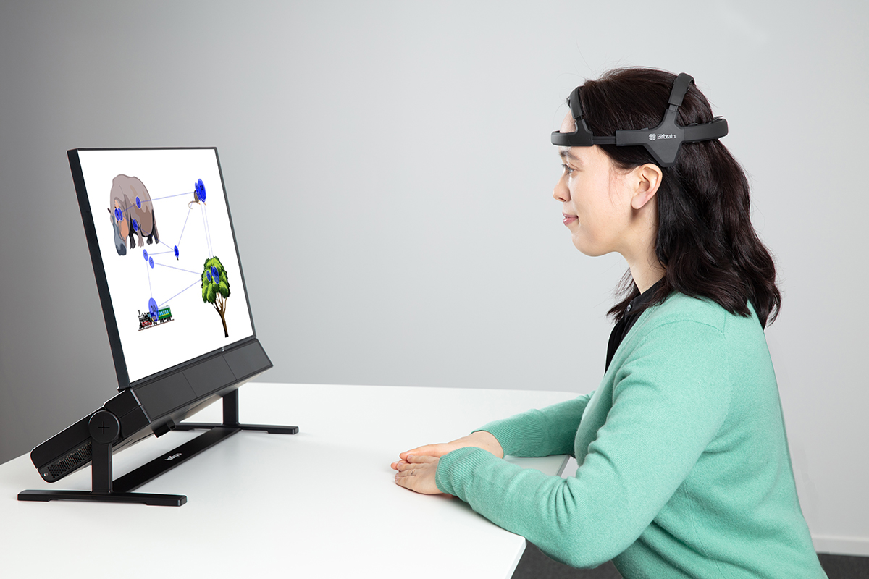
COORDINATION
Combine Techniques: Triangulation
Photo Source: https://www.tobii.com/products/eye-trackers/screen-based/tobii-pro-spectrum
12

Slide 14
DATA ANALYSIS
From Data to Meaning
Qualitative
Quantitative
Interpreted to tell the “story” of what was observed
Drawn from interaction & video logs
Categorized with techniques such as content analysis
Presented as values, tables, charts, graphs
Output: themes, incidents, breakdowns, quotes
Output: treated statistically — means, frequencies, tests
14

Slide 15
MAKING QUALITATIVE DATA RIGOROUS
Technical Deep Dive — Coding & Reliability
A coding scheme
Define mutually-exclusive codes before analysis, e.g.:
Navigation confusion — user unsure where to go next
Feature discovery — user finds a feature unprompted
Error recovery — user recovers from a mistake
Two independent coders label the same transcript with these codes — then we check how well they agree.
15

Slide 16
MAKING QUALITATIVE DATA RIGOROUS
Principal Component Analysis (PCA) for User Behaviour Analysis
Why do we need PCA?
Modern HCI systems collect a large number of interaction features from users.
Example:
      Number of mouse clicks
      Mouse movement distance
      Mouse velocity
      Typing speed
      Scroll count
      Eye fixation duration
      Blink rate
      Task completion time
      Error count
      Idle time
Now suppose we collect 20 features from 5,000 users.
15

Slide 17
MAKING QUALITATIVE DATA RIGOROUS
Principal Component Analysis (PCA) for User Behaviour Analysis
Why do we need PCA?
Problem
  Difficult to visualize
  Many features are redundant
  Some features are highly correlated
  Machine learning becomes slower
  Noise increases
Solution: Principal Component Analysis (PCA)
15

Slide 18
MAKING QUALITATIVE DATA RIGOROUS
Principal Component Analysis (PCA) for User Behaviour Analysis
What is PCA?
PCA is a statistical technique that transforms many correlated variables into a smaller number of new variables (called Principal Components) while preserving as much information as possible.
Instead of analyzing
20 features
we may analyze only
2 or 3 Principal Components
that explain 90–95% of the original information.
15

Slide 19
MAKING QUALITATIVE DATA RIGOROUS
Principal Component Analysis (PCA) for User Behaviour Analysis
PCA Workflow
Step 1
Collect user interaction data.
↓
Step 2
Standardize the features.
↓
Step 3
Measure relationships among features.
↓
Step 4
Identify the directions that contain the most information.
↓
Step 5
Replace many variables with a few Principal Components.
↓
Step 6
Interpret the Principal Components.
15

Slide 20
MAKING QUALITATIVE DATA RIGOROUS
Principal Component Analysis (PCA) for User Behaviour Analysis
Example Dataset
Suppose we collect data through Observation from Users
many clicks also have
long mouse movement
faster typing
The three variables are highly correlated.
What is a Principal Component?
A Principal Component is
A new feature created by combining several original features.
Example
Original features
              Mouse clicks
              Mouse distance
              Typing speed
↓
              Principal Component
Interaction Intensity
User | Clicks | Mouse Distance | Typing Speed
A | 15 | 220 | 35
B | 18 | 240 | 38
C | 40 | 610 | 72
D | 38 | 590 | 70
15

Slide 21
MAKING QUALITATIVE DATA RIGOROUS
Principal Component Analysis (PCA) for User Behaviour Analysis
Another example
Original features
      Eye fixation duration
      Blink rate
      Pupil size
↓
    Principal Component
Cognitive Workload
15

Slide 22
MAKING QUALITATIVE DATA RIGOROUS
Principal Component Analysis (PCA) for User Behaviour Analysis
Interpreting Principal Components
These names are assigned by the researcher after examining which original features contribute most to each component.
Component | Interpretation
PC1 | Interaction Intensity
PC2 | Cognitive Workload
PC3 | Typing Behaviour
15

Slide 23
MAKING QUALITATIVE DATA RIGOROUS
Principal Component Analysis (PCA) for User Behaviour Analysis
Variance Explained
Each Principal Component explains a certain amount of information.
Example
Interpretation
Only PC1 is sufficient because it already explains most of the user behaviour !!!
Component | Information Explained
PC1 | 92%
PC2 | 6%
PC3 | 2%
15

Slide 24
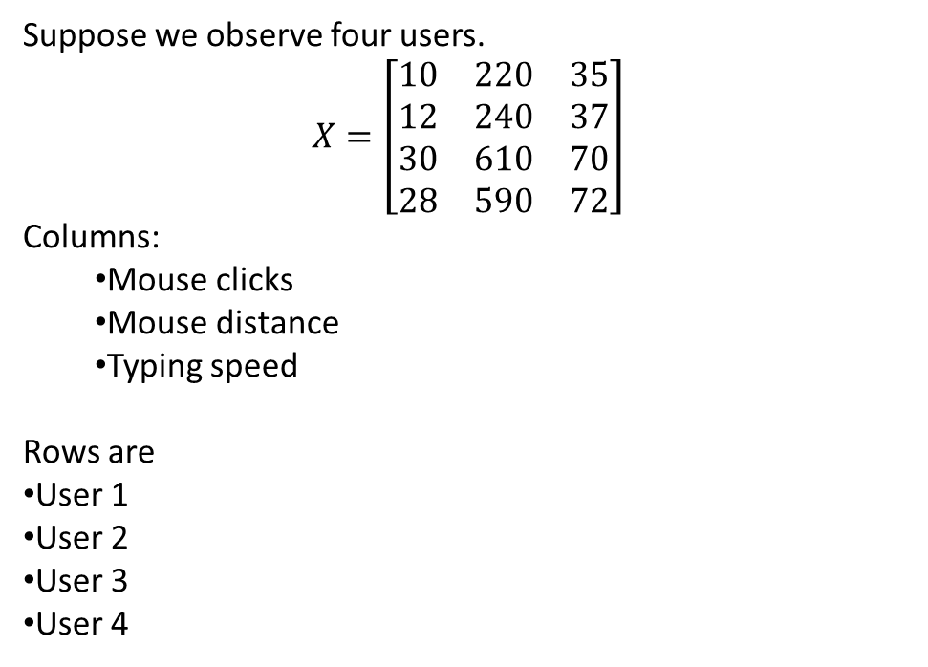
MAKING QUALITATIVE DATA RIGOROUS
Principal Component Analysis (PCA) for User Behaviour Analysis
Step 1. User Behaviour Matrix
Suppose we observe four users.
$$X=\left[\begin{matrix}10 & 220 & 35 \\ 12 & 240 & 37 \\ 30 & 610 & 70 \\ 28 & 590 & 72\end{matrix}\right]$$
Columns:
  Mouse clicks
  Mouse distance
  Typing speed
Rows are
User 1
User 2
User 3
User 4
15

Slide 25
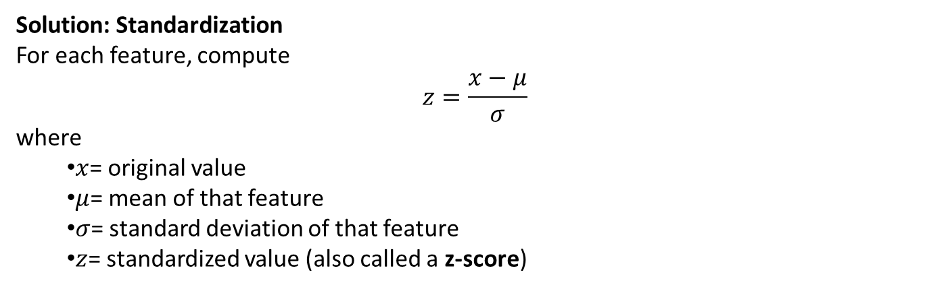
MAKING QUALITATIVE DATA RIGOROUS
Principal Component Analysis (PCA) for User Behaviour Analysis
Step 2. Standardize the Data
Solution: Standardization
For each feature, compute
$$z=\frac{x−μ}{σ}$$
where
  $x$= original value
  $μ$= mean of that feature
  $σ$= standard deviation of that feature
  $z$= standardized value (also called a z-score)
15

Slide 26
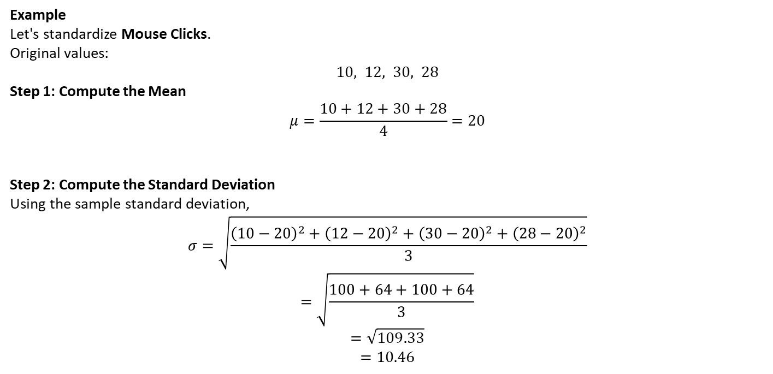
MAKING QUALITATIVE DATA RIGOROUS
Principal Component Analysis (PCA) for User Behaviour Analysis
Example
Let's standardize Mouse Clicks.
Original values:
$$10, 12, 30, 28$$
Step 1: Compute the Mean
$$μ=\frac{10+12+30+28}{4}=20$$
Step 2: Compute the Standard Deviation
Using the sample standard deviation,
$$σ=\sqrt{\frac{{\left(10−20\right)}^{2}+{\left(12−20\right)}^{2}+{\left(30−20\right)}^{2}+{\left(28−20\right)}^{2}}{3}}$$
$$=\sqrt{\frac{100+64+100+64}{3}}$$
$$=\sqrt{109.33}$$
$$=10.46$$
15

Slide 27
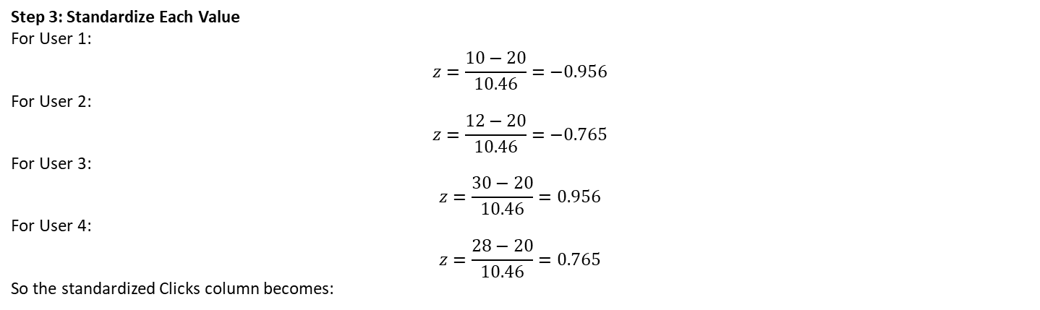
MAKING QUALITATIVE DATA RIGOROUS
Principal Component Analysis (PCA) for User Behaviour Analysis
Step 3: Standardize Each Value
For User 1:
$$z=\frac{10−20}{10.46}=−0.956$$
For User 2:
$$z=\frac{12−20}{10.46}=−0.765$$
For User 3:
$$z=\frac{30−20}{10.46}=0.956$$
For User 4:
$$z=\frac{28−20}{10.46}=0.765$$
So the standardized Clicks column becomes:
User | Original | Standardized
U1 | 10 | -0.956
U2 | 12 | -0.765
U3 | 30 | 0.956
U4 | 28 | 0.765
15

Slide 28
MAKING QUALITATIVE DATA RIGOROUS
Principal Component Analysis (PCA) for User Behaviour Analysis
Repeat for Every Feature
Need to do the same for Mouse Distance and Typing Speed.
The standardized data matrix might look like this:
Notice that the values are now all on a similar scale, making the features directly comparable.
User | Clicks | Distance | Typing
U1 | -0.96 | -0.92 | -0.94
U2 | -0.77 | -0.82 | -0.82
U3 | 0.96 | 0.97 | 0.90
U4 | 0.77 | 0.77 | 0.86
15

Slide 29
MAKING QUALITATIVE DATA RIGOROUS
Principal Component Analysis (PCA) for User Behaviour Analysis
Why PCA is Useful in HCI
Removes redundant features.
Simplifies large datasets.
Makes visualization easier.
Speeds up machine learning algorithms.
Reduces noise.
Helps identify hidden behavioural patterns.
Improves clustering and classification accuracy.
Limitations
Principal Components are not always easy to interpret.
PCA assumes linear relationships among variables.
Results depend on proper feature scaling (standardization).
Important information may be lost if too few components are retained.
15

